Slide 1
MATLAB Programming
Programming Assignment Four
Instructor: 黃世強 (Sai-Keung Wong)

Slide 2
About the demo video
A demo video may have bugs. The demo video shows roughly the results. These results may not be exactly the same as the requirements. They are for your own reference. You must follow the instruction to finish your programs.

Slide 3
Program file name format
Write all your programs in a folder. The folder name is your hw04_student_ID.
Zip the folder and upload it.
Write a program for each problem in one file.
The file name is hw04_X_yourStudentID.m, where X is the problem number.
For example, if your student ID is 12345678 and the problem number is 3, then the file name must be hw04_3_12345678.m.
Do not output all the intermediate results.
Output the results that are required only.
For animation, it must be interactive.

Slide 4
For each problem, display the problem number before showing the results.
clf; clear; clc; % clear the current figure
% clear variables, and clear screen
disp(‘HW04 Problem 4.1’) % show HW04 Problem 4.1

Slide 5
Program Header
At the top of the file, write down your name, ID, email address, department, and date.
%%%%%%%%%%%%%%%%%%%%%%%%%%%
% Assignment Number: …
% Problem number: …
% Student Name: …
% Student ID: …
% Email address: …
% Department:
% Date: ….
%%%%%%%%%%%%%%%%%%%%%%%%%%%%

Slide 6
(50%) Problem 4.1.
Assume that Y is generated randomly in a uniform manner inside [0,1].
Let X = F(Y) = aY² + bY + c.
Ask to input a, b, and c. Assume that each of them is nonzero. The valid input is that all of a, b, and c have the same sign.
Ask to input the number of samples of X. Let the number be n. Implement the following steps:
If n is zero, quit the program. n is inside [0, 1000000].
Ask to input a, b, and c. Check if they are valid. If they are invalid, show a message and then quit the program.
Clear the figure(s).
Randomly generate n samples of X.
Report the average (M) and standard deviation (SD) of the n samples as the title of the figure. Also, report a, b, and c. The format is: M= …; SD= …; a=…; b=…; c=…
Show the n samples in a histogram in pdf format in a figure H.
Draw the pdf of X on the same figure H.
Animate a point to move along the curve of the pdf from right to left.
Go to step 1.

Slide 7
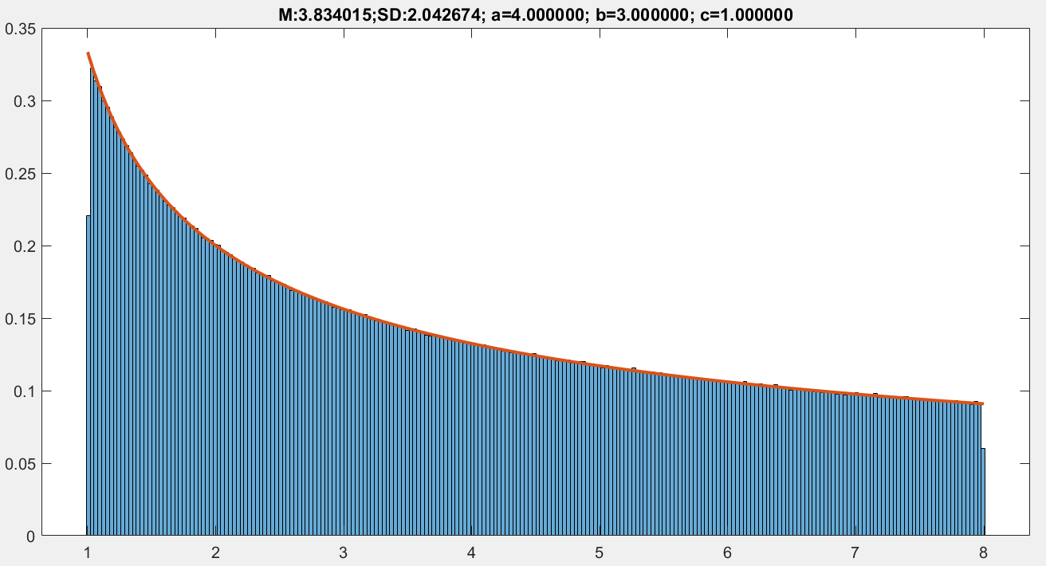
Problem 4.1

Slide 8
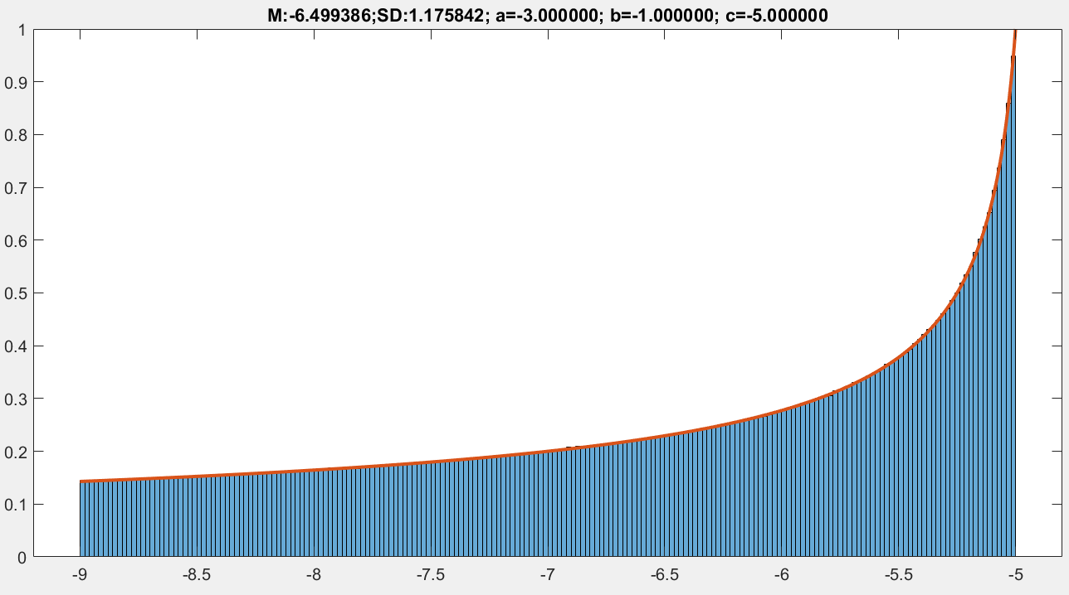
Problem 4.1

Slide 9
(50%) Problem 4.2
There are four functions which are defined as follows.
y1(x) = sin(x); y2(x) = cos(2x); 3(x) = x²sin(x)e^{-(x-1)}; y4(x) = 4-x/2
Ask to input x0 inside [0, 10]. If x0 is 0, quit the program.
Use a 2x2 grid on a figure. Draw the curves of all the functions for x inside [0, 10]. Each curve is drawn in a subfigure. Set the step size properly so that all the curves are smooth.
Animate all the figures for x from 0 to 10. Set pause duration as 0.025 for each step. The animation must be interactive.
While x changes, a line segment ((x, yi(x)), (x, 0)) is drawn on the respective figure for each curve i.
Compute the area of a region for each curve. The area is bounded by the curve, the axis, and the x-coordinate interval inside [0, x0].
Sort the areas in ascending order. Thus each function is associated with an order number.
Show a title of each figure, and also the order number in the sorted result. The format of the title is as follows:
(order number): function definition: Area = …

Slide 10
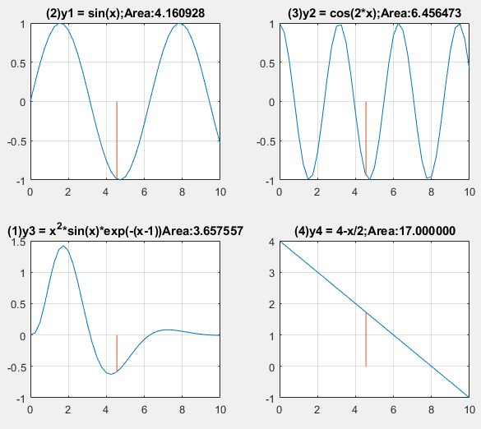
Problem 4.2
There are four functions which are defined as follows.
y1(x) = sin(x); y2(x) = cos(2x); 3(x) = x²sin(x)e^{-(x-1)}; y4(x) = 4-x/2
Show a title of each figure, and also the order number in the sorted result. The format of the title is as follows:
(order number):
function definition: Area = …
Hint: area = int(abs(yi),x,0,x0).
x0 =10

Slide 11
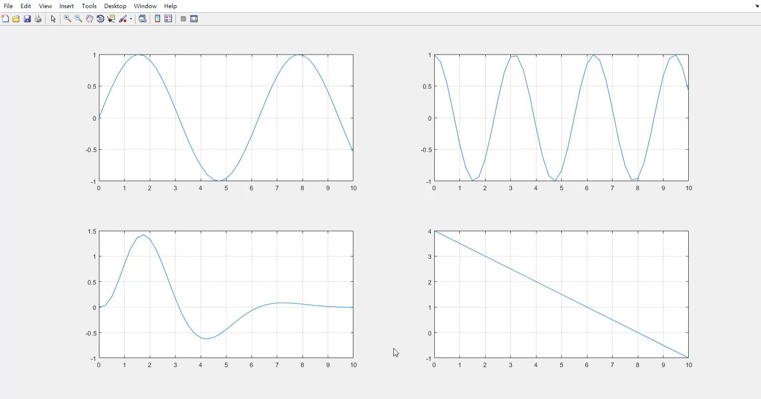
Problem 4.2. Example

Slide 12
End
Enjoy MATLAB Programming.

